Slide 1


Review of EOSC integration (WP6)
7 July 2021
Authors: Andy Götz (coordinator)+ Jean-Francois Perrin (WP6 leader)
Place: PaNOSC Project Management Committee zoom meeting
This project has received funding from the European Union’s Horizon 2020 research and innovation programme under grant agreement No. 823852

Slide 2
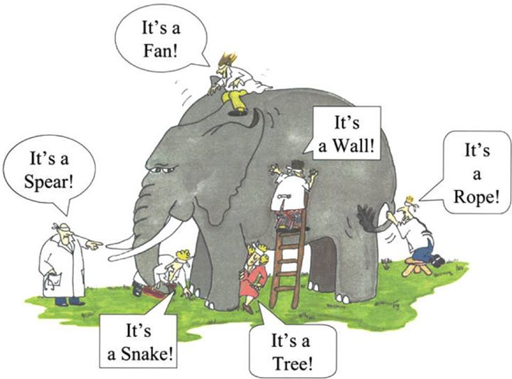
What is the EOSC ?

Slide 3
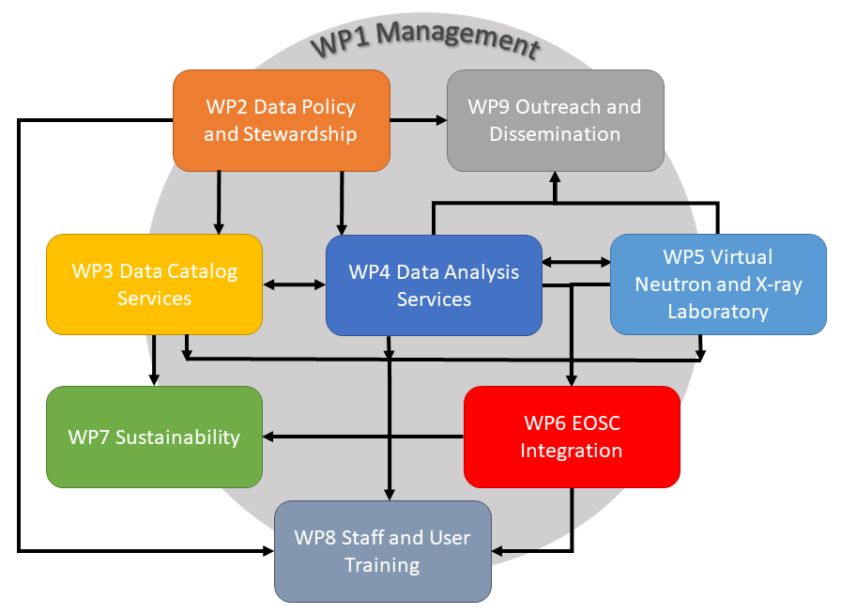
WP6
Data Catalog Services – their role in PaNOSC
This project has received funding from the European Union’s Horizon 2020 research and innovation programme under grant agreement No. 823852

Slide 4
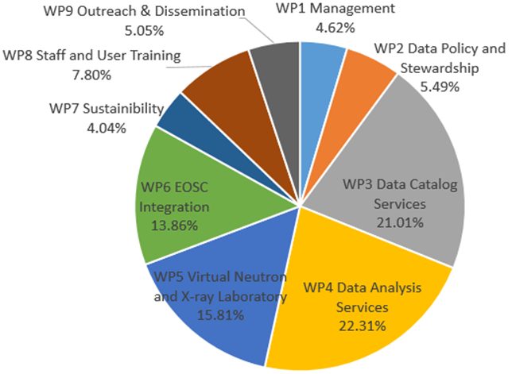
WP6
EOSC Integration – 4th largest WP of PaNOSC
This project has received funding from the European Union’s Horizon 2020 research and innovation programme under grant agreement No. 823852

Slide 5
WP6
Sustainability – Effort per partner
1 – EGI.EU 83.00
2 – ILL (absent) 38.00 (WP leader)
3 – ESRF 21.00 54.00 (WP leader)
4 – ESS 13.00
5 – EuXFEL (absent) 13.00
6 – CERIC-ERIC 13.00
7 – ELI-DC 12.00
Total 193.00 (~ 16 years)
This project has received funding from the European Union’s Horizon 2020 research and innovation programme under grant agreement No. 823852

Slide 6
WP6 Objectives from Proposal
This work aims to integrate the PaNOSC cluster with EOSC through a strong collaboration the EOSC-Hub project and more generally with the e-Infrastructures and other Research Infrastructures jointly contributing to the realization of the EOSC Hub.
Effort will be on three levels:
Strategic: by engaging with other EOSC stakeholders in order to contribute to the definition of the EOSC implementation roadmap.
Executive: by contributing PaNOSC data, resources and services to the EOSC service catalogue.
Technical: by making use of relevant EOSC services (e.g. AAI, marketplace, Cloud Compute, Data Archiving and Data Management services)

Slide 7
WP6 Tasks from Proposal
Task 6.1 Management of the Interaction with the e-Infrastructures (ILL)
Task 6.2 EOSC Hub Service Catalogue (ESRF)
Task 6.3 Data availability for the services (ELI)
Task 6.4 Authentication Authorisation Infrastructure (AAI) integration (ILL)
Task 6.5 Services Support (ELI)
Task 6.6 PaN Software catalogue (ILL)
Task 6.7 Data archiving pilot (ELI)
Task 6.8 Procurement of commercial cloud services (ESRF)

Slide 8
WP6 Deliverables from Proposal
Deliverable 6.1 EGI data-hub integration with the facilities’ data repositories (M18, ELI)
Deliverable 6.2 Integration of local compute resources into the EOSC cloud (M12, ELI)
Deliverable 6.3 Integration of the PaN AAI into the EOSC (M36, ILL)
Deliverable 6.4 Demonstration of the PaN software catalogue integration into EOSC (M24, ILL)
Deliverable 6.5 Report on EOSC integration (M48, ILL)

Slide 9
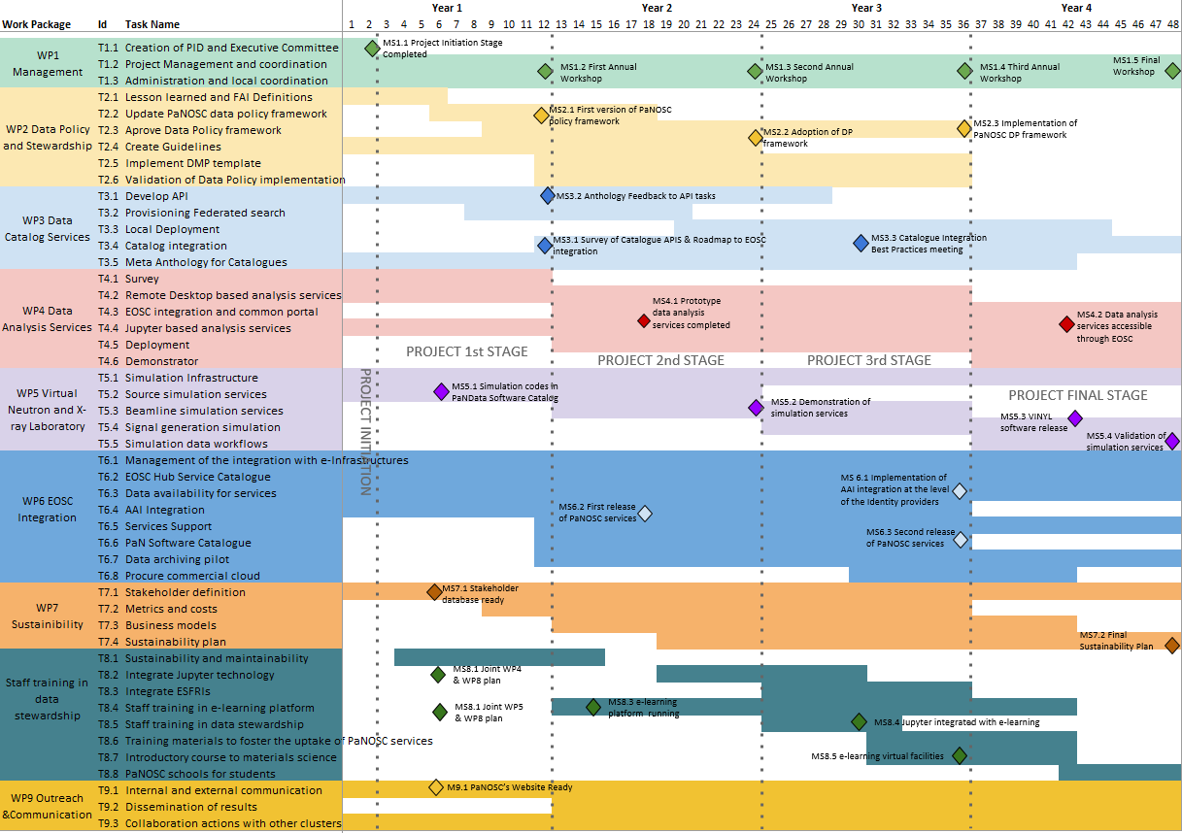
July 2021
PaNOSC Milestones

Slide 10
Inventory of what needs to be sustained
Data catalogs – SciCat, Icat, local ingestion + archiving
Data format – HDF5, Nexus, compression filters
Data portals – search API + portal + browser (h5web)
Data transfer – download + transfer services
Data Analysis – VISA portal, Jupyterlab + Binder
Authentication + Authorisation Infrastructure – Umbrella AAI
Data Analysis software – software in pan-software catalog
Simulation software – SIMEX, OASYS, notebooks, workflows
Training platform – pan-learning.org, pan-training.org, training

Slide 11
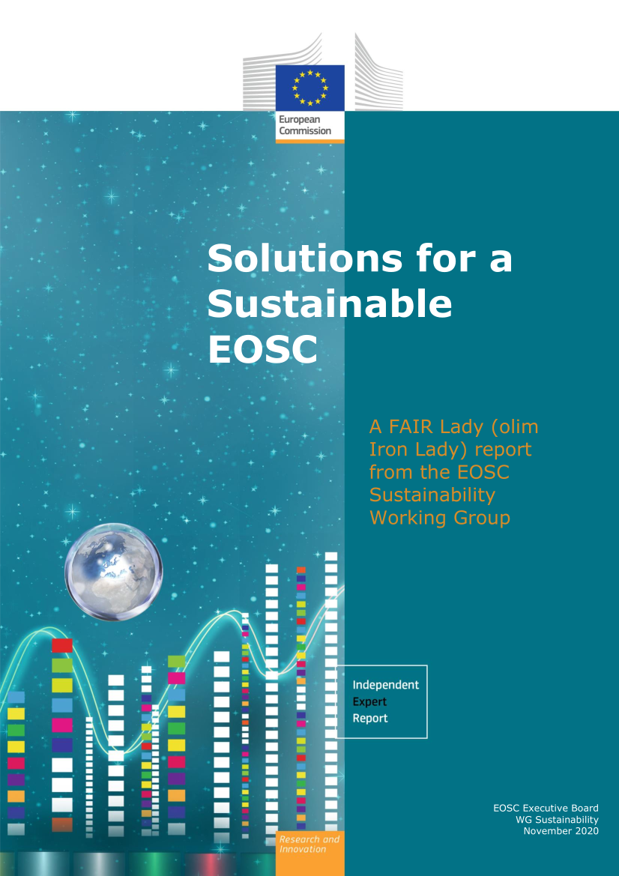
ESFRIs EOSC contribution already funded?
Under the Research Infrastructures Work Programme of Horizon 2020, the EC has provided support to actions that connect the ESFRI infrastructures to EOSC and promoted research data sharing by default.
This implies that PaNOSC partners are already funded for the EOSC …

Slide 12
EOSC recognizes that RIs are funded for their community of users
It is recognised that the services provided by publicly funded organisations frequently have a mandate and a budget to serve a well-defined set of users that may be delimited by research discipline or geographical boundaries, and that broadening access to those services may generate additional costs.
As an incentive to encourage service providers to participate in EOSC-Exchange and open up their services to all publicly funded researchers, the projects to be funded via calls such as INFRAEOSC-07-2020 will offer an EC-funded means, based on the Horizon 2020 Virtual Access71 scheme, to compensate service providers for the additional operational costs they incur.
The Virtual Access (VA) instrument is provided by the European Commission to increase the sharing of research infrastructures and services that otherwise would not be available to international user groups. In VA, the services – also called “installations” – have to be made available ‘free of charge at the point of use’ for European or International researchers. VA access is open and free access to services through communication networks to resources needed for research, without selecting the researchers to whom access is provided.

Slide 13
Issues for WP6 in PaNOSC
Engagement
Lack of engagement (EuXFEL, ILL, …)
AAI
UmbrellaId to be adopted by all sites
EGI resources
Lack of sites using the EGI archiving
Lack of sites using the EGI compute resources
Data Transfer
Still no final decision on OneData solution
Will Globus be deployed at all sites?
Commercial cloud – only a few use cases

Slide 14
Issues for EOSC
EOSC is still evolving and missing many key features e.g. common AAI, helpdesk, data transfer, compute resources
Services need to be sustained by individual sites after PaNOSC

Slide 15
PaNOSC WP6 spending up to 31/3/2021
WP6
66% Spent, 33% Underspending

Slide 16
PaNOSC WP6 spending up to 31/3/2021
WP6
Underspending by EuXFEL + ILL

Slide 17
PaNOSC WP6 spending up to 31/3/2021
WP6
Overspending by CERIC-ERIC, Underspending by ESRF

Slide 18
For the remainder of PaNOSC
All partners to engage in WP6 activities especially AAI, data transfer, VISA portal, software catalog, compute resource usage, archiving, etc.
Need more services declared in EOSC portal including data services using (exclusively?) UmbrellaId
Involvement in EOSC activities e.g. Task Forces

